Slide 1
Employee Attrition Analysis
by DDSAnalytics Company
Eny Ntuk
Date: December 9, 2022

Slide 2

Objective
This study is to analyze and identify the top 3 factors that contribute to turnover (attrition) in this talent management company. And, to make recommendations for HR department to help improve talent management and to show any job role specific trends that may exist in the data set. To build a model to prediction "Attrition" and "Monthly Income for employees.
• Provide employee attrition analysis to DDSAnalytics Company
• Show factors that lead to attrition and provide the 3 top factors from the data analysis
• Factors that contribute to monthly income
Build a model to predict attrition and monthly income for given test dataset
• All Data analysis and predictions are done in R language

Slide 3
Attrition Dataset Preprocessing
Description:
There is one dataset, “CaseStudy2-Attrition" which contains 870 current and former employee data with 36 employee variable attributes.
Removed variables that hold constant value across dataset (Over18, with all observations with 80, StandardHours, with all observations with Y and EmployeeCount, with all observations with 1, and EmployeeNumber)
No missing values were found in the dataset
Converted Categorical variables to Numerical variables to help with modeling and prediction accuracies
Significant Dataset Attributes Affecting Attrition:
• Age
• Businesstravel
• Department
• Education
• PerformanceRating
Jobinvolvement
Jobsatisfaction
Maritalstatus
• Numcompaniesworkd
• Overtime
Relationshipsatisfaction
Worklifebalance
Yearsincelastpromotion
EnvSatisfaction
Distancefromhome

Slide 4

Top 3 Attrition Causes
Attrition at 16%, 140 Employees left the company
No Attrition at 84%, 730 Employees stayed in the company
Over Time
Job Role
Monthly Income

Slide 5
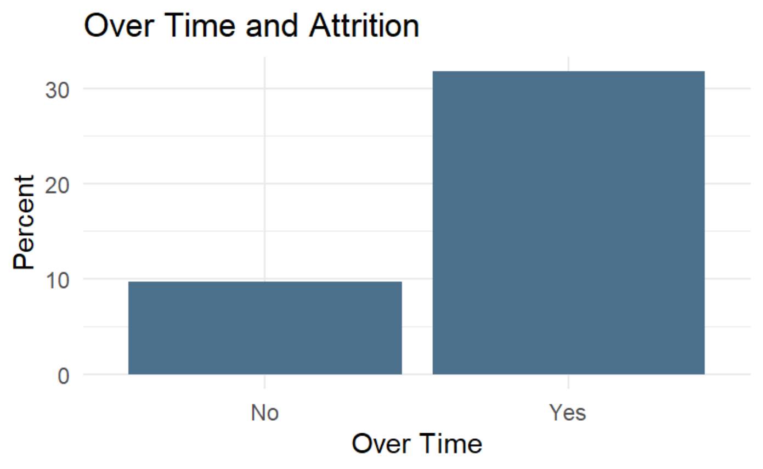
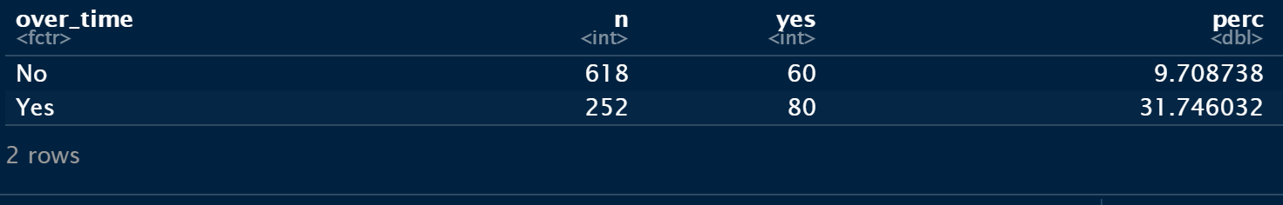
Over Time and Attrition
• 252 Employees worked overtime and 80 employees that worked overtime left the company which resulted at an attrition rate of 31.75%
618 employees did not work overtime with an attrition rate of 9.70% and 60 employees leaving the company.

Slide 6
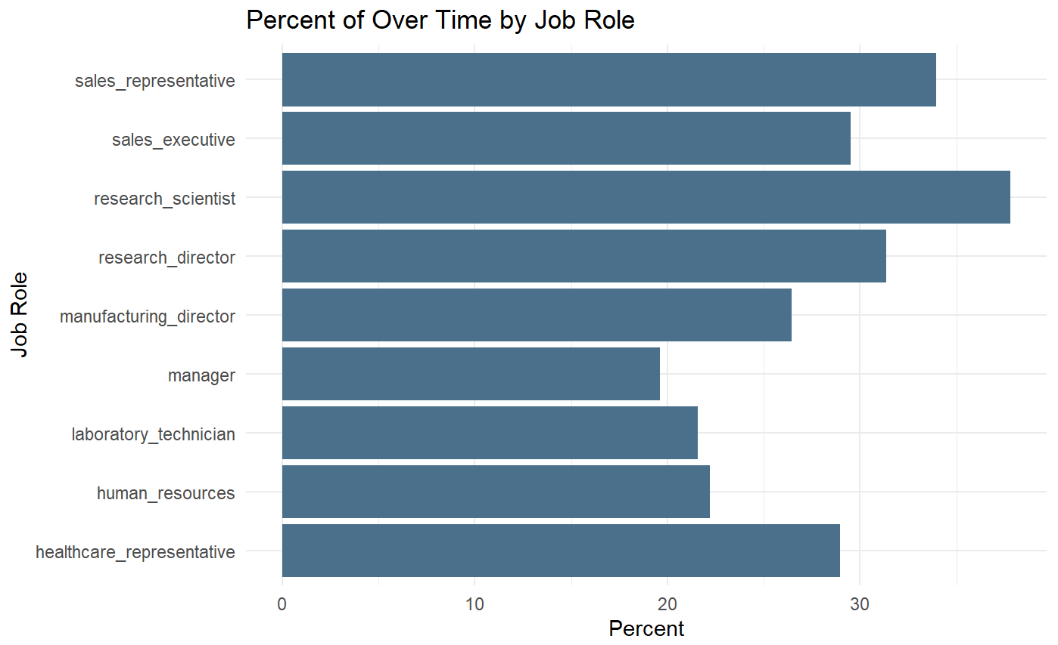
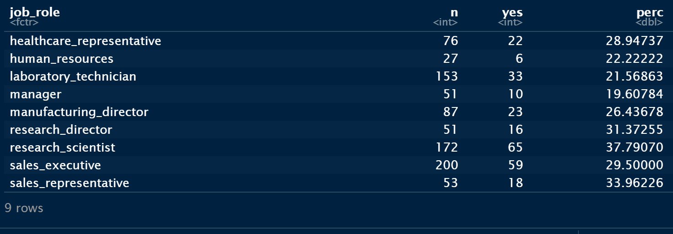
Over Time by Job Role
• Managers worked the least over time at 19.60% and the Research Scientist worked the most over time at 37.79%.
Employees that worked a lot of overtime are more likely to result in attrition.

Slide 7
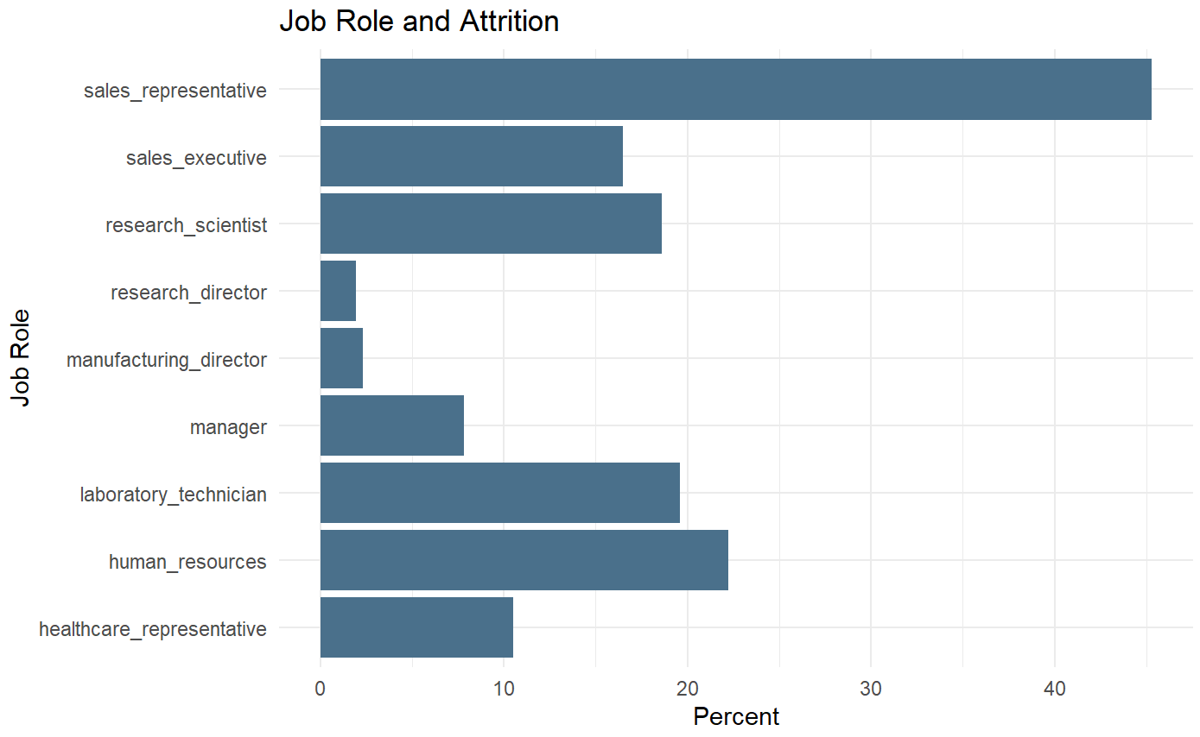
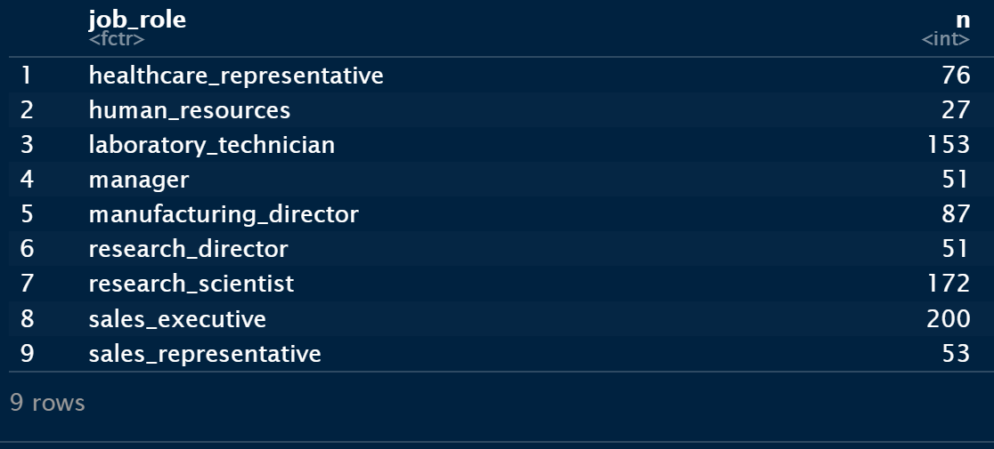
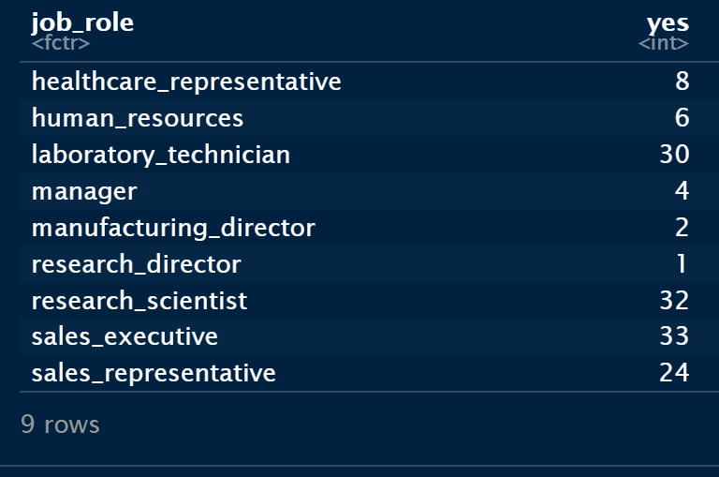
Job Role and Attrition
• The attrition rate of Sales Representatives was the highest of all job roles at 45.28% and the lowest was the Research Directors at 1.96%.

Slide 8
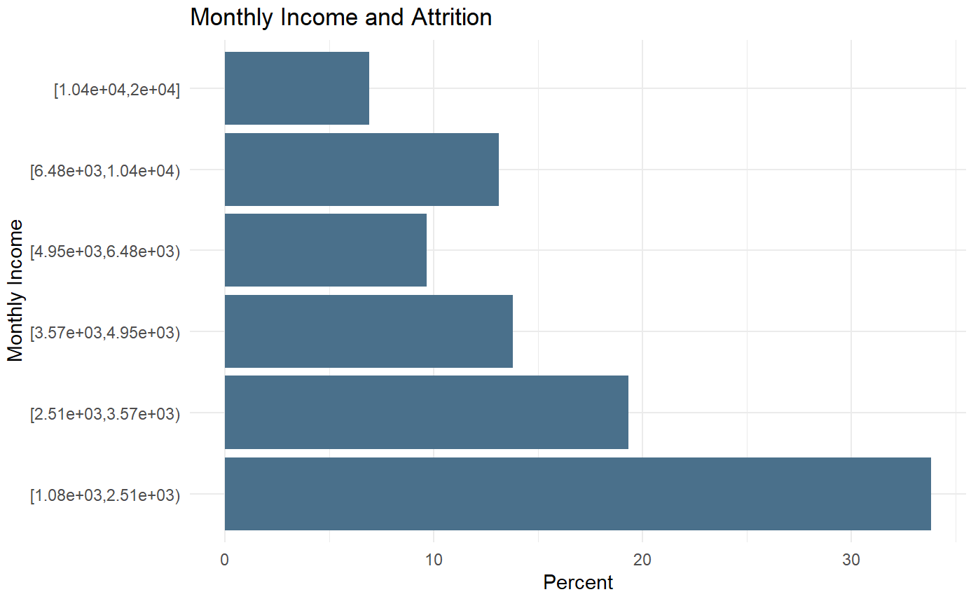
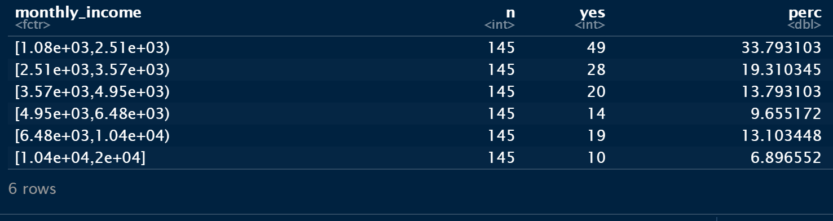
Monthly Income and Attrition
• Employees that earn $1080 to $2510 in monthly income left the company with a high attrition rate of 33.79%, while Employees who earn $10,400 to $20,000 had the least attrition rate of 6.90%
Employees with a higher salary are less likely to leave the company.

Slide 9
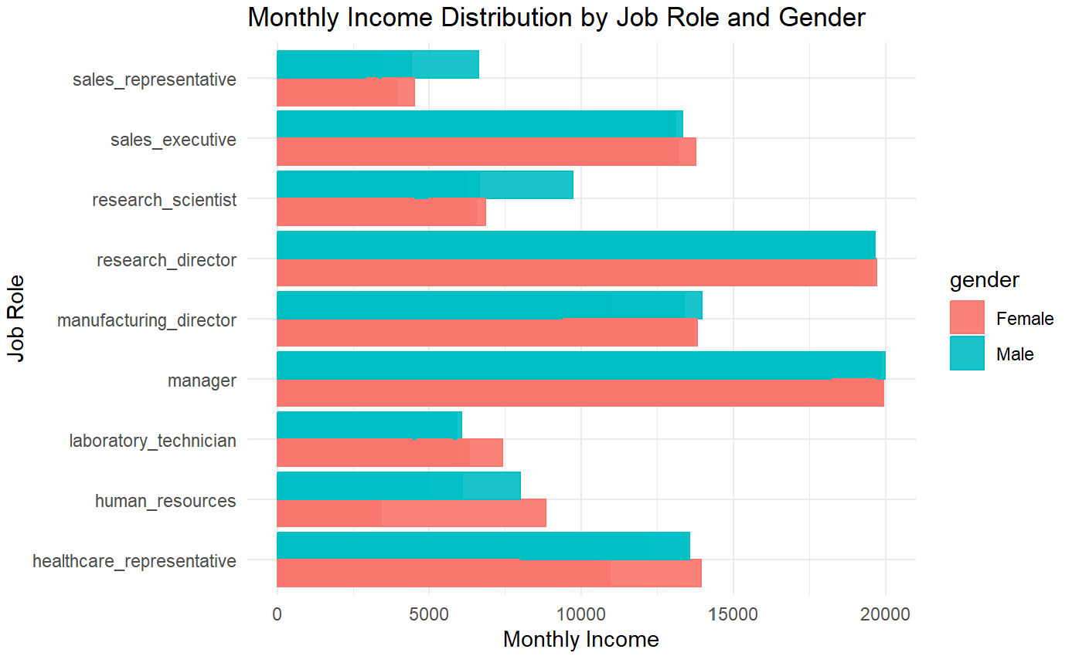
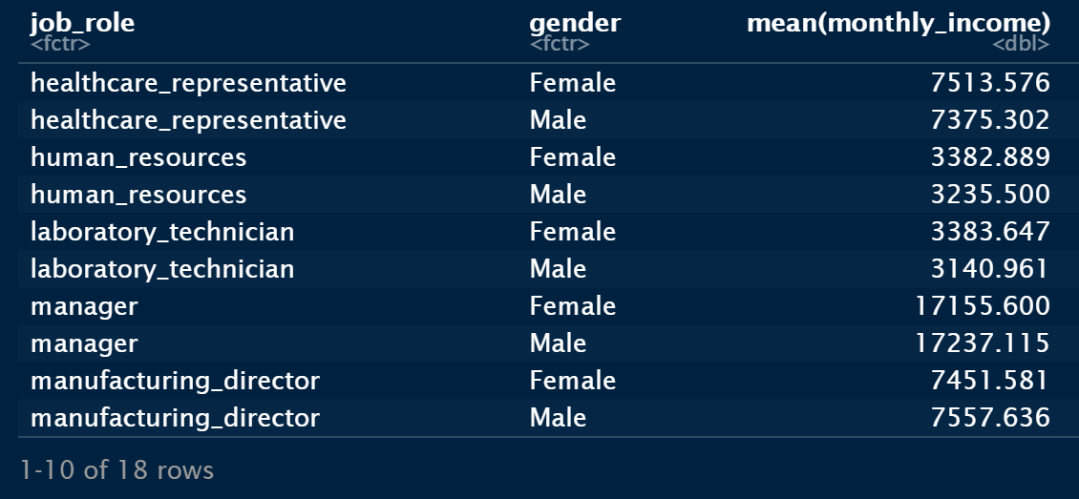
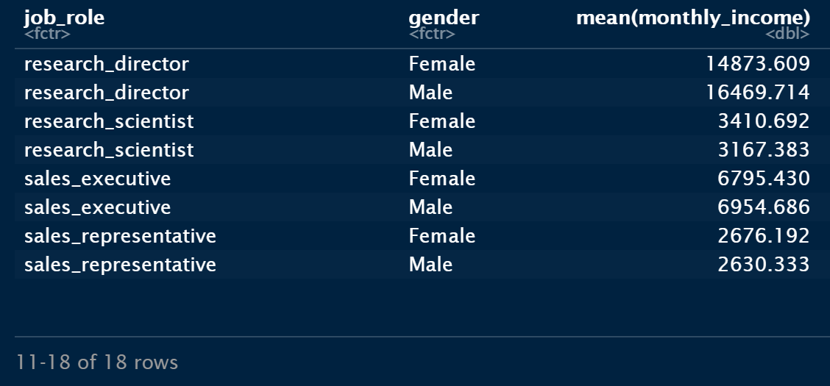
Monthly Income by Job Role and Gender
• There was not much disparity between gender, job role and monthly income.
Male employees represent 59% of the total number of employees and 41% represent female employees.

Slide 10
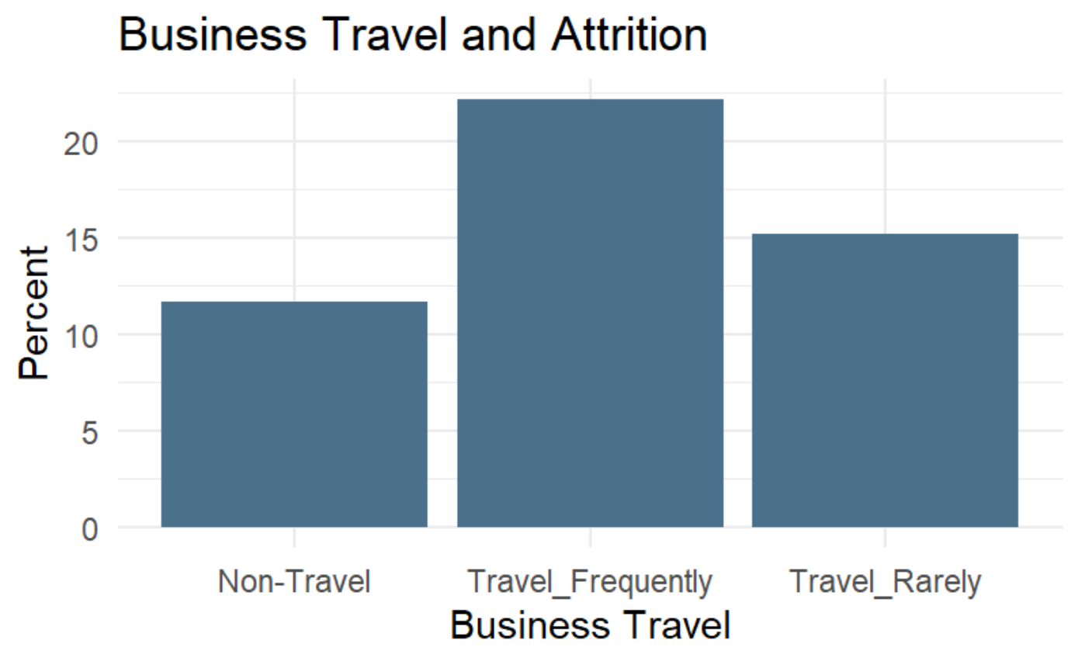

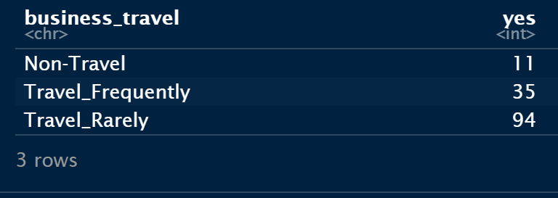
Travel Frequency
• Employees who travel frequently showed a higher attrition rate compared to employees who travel rarely or do not travel at all. Out of 158 employees that travel frequently, 35 of them left the company that resulted in anattrition rate of 22.15%. On employees that travel rarely, 94 of 618 employees left the company at an attrition rate of 15.21% and the non- travelers at 11.70% attrition.

Slide 11
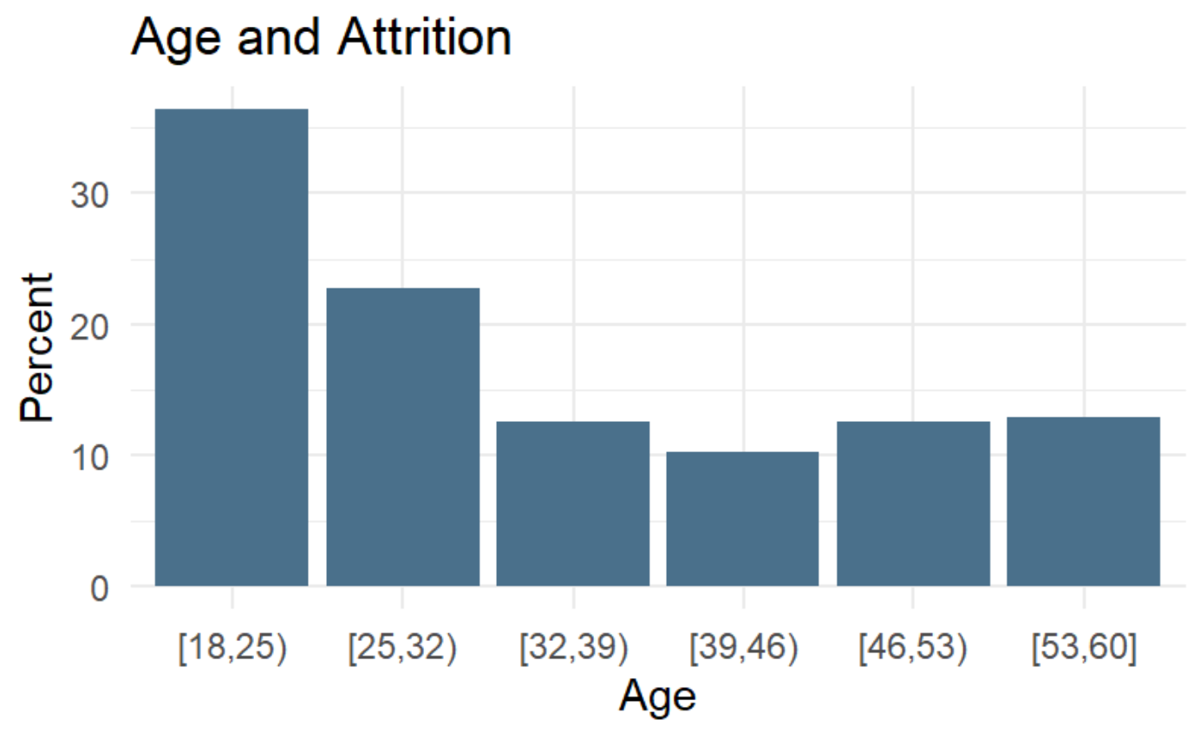
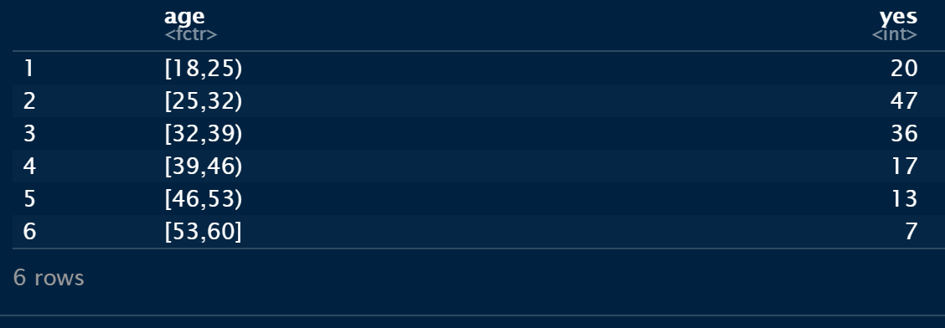
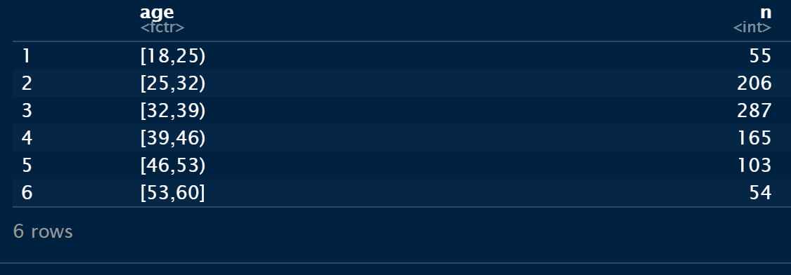
Age
• Employees in their 20’s are more likely to leave the company at 36.36% of attrition and older employees tend to stay with the company.
Employees’ age range is from 18 to 65 years old.

Slide 12
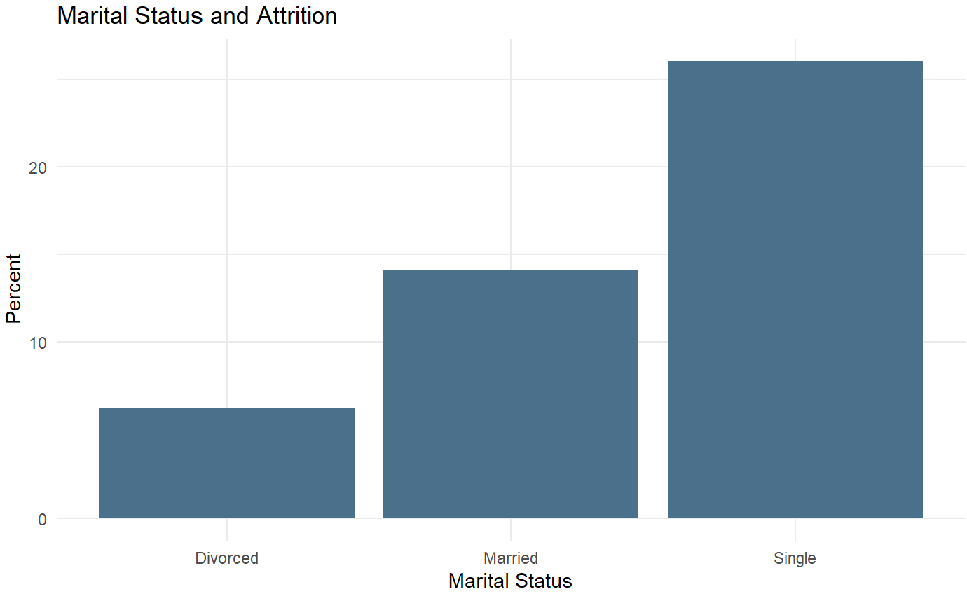
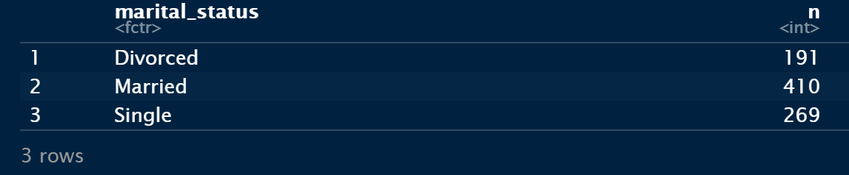
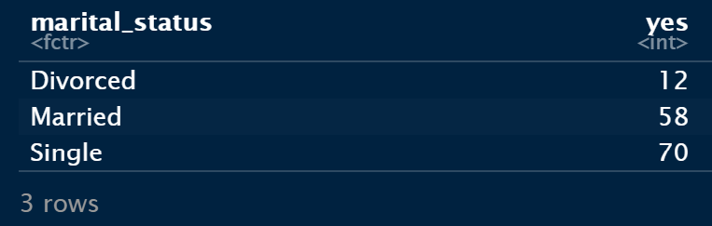
Marital Status and Attrition
• The single employees are more likely to leave the company at an attrition rate of 26% than the divorced employees.

Slide 13
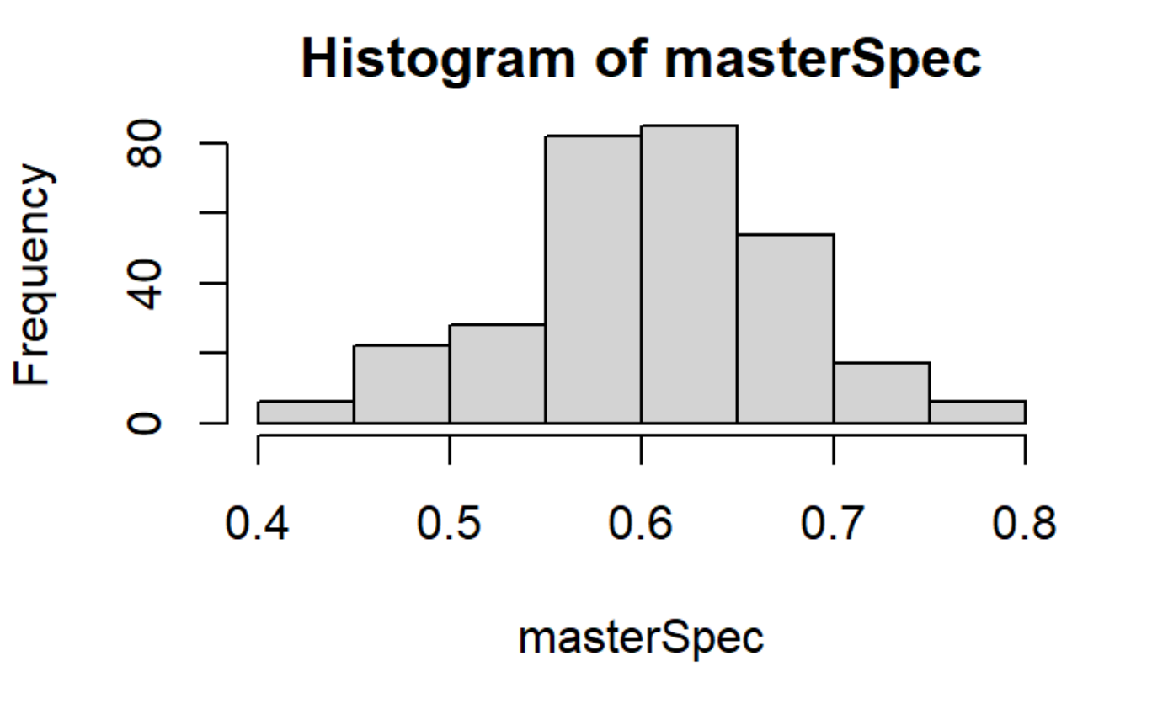
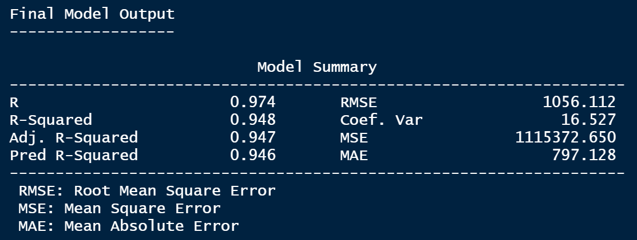
Attrition Prediction Model
KNN
Model Metrics
RMSE of 7897.961 is too high, so considered an alternative model Naïve Bayes
Naïve Bayes
Model Metrics
• Sensitivity: 84.6%
• Specificity: 60.63%
Accuracy: 80.7%
RMSE: 1056.112

Slide 14
Conclusion
• Employees making less than $5000 monthly have the highest attrition rate.
• Over Time, Job Role and Monthly Income are the top 3 factors affecting attrition rate.
• Employees with less than 5 years at company or 5 total working years are more likely to leave the company.
The job title with the highest attrition percentage is Sales Representatives.
• Naïve Bayes provides the best prediction model with accuracy of 80.7%.
Recommendations
• Reduce overtime for Research Scientists, Sale Representatives, Sales Executives, Healthcare Representatives and Manufacturing Managers.
• Increase the monthly income for employees making less than $3000 monthly.

Slide 15
Questions?
Contact Info
Eny Ntuk via email at entuk@smu.edu

Slide 16


Thank You

